Slide 1

KhattTech UI/UX
Arabic Handwritten Recognition Mobile Application
Sondos Aabed
March.2025 – July.2025
Tools:
Figma, Google Forms, Pyhton, Github, Miro, Whimsical

Slide 2

Project Overview
Arabic handwritten recognition holds exciting promise, but current tools are falling short of user expectations.
Through this research, I discovered that frequent users, ranging from students to professionals, are frustrated by poor accuracy, limited support for diverse handwriting styles, and lack of flexible export options. Over half of respondents reported dissatisfaction, making it clear that usability gaps are getting in the way of real-world adoption.
At the same time, there’s strong interest in mobile solutions, especially free, ad-supported apps. These insights uncovered not just pain points, but a valuable opportunity to innovate, enhance accessibility, and create a product that truly aligns with users’ needs and behaviors.

Slide 3
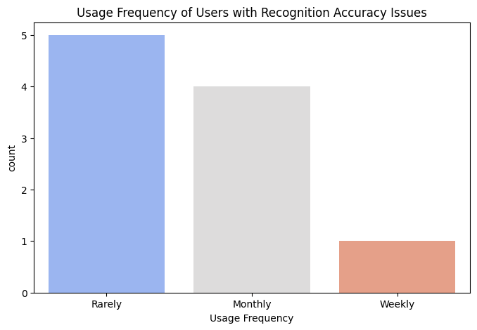
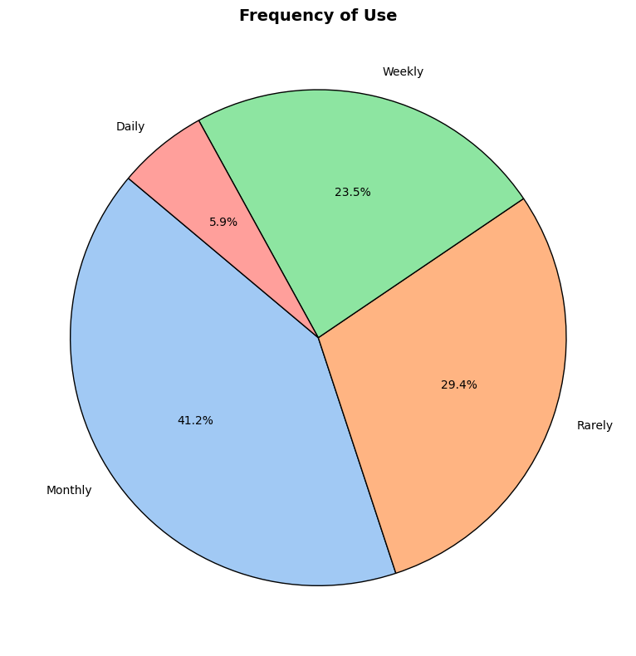
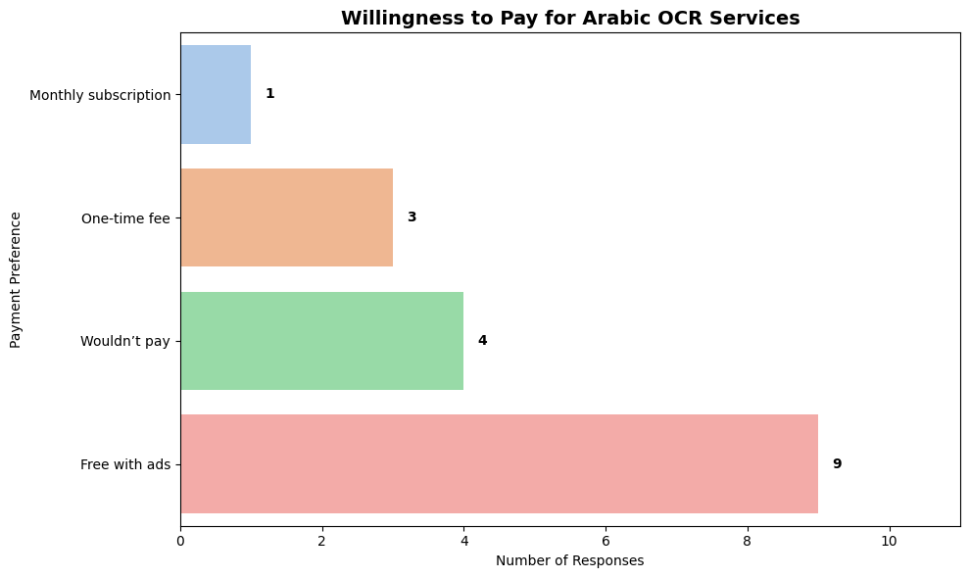
Discovery: Research & Analysis

Slide 4
🔍 Discovery Process
To understand how users experience Arabic handwritten recognition tools, I used a mixed-methods approach combining both qualitative and quantitative data.
I conducted 1-on-1 interviews with 5 participants from Palestine, representing a range of backgrounds and genders:
1 Educator (Teacher/Professor)
2 Students
1 Documentation & Archiving Professional
1 General User
In parallel, I distributed surveys to 17 participants to gather broader insights across different backgrounds based on Palestine mainly. Where I utilized LinkedIn platform is used for reach different audiences backgrounds.
This approach allowed me to look into personal experiences while also validating patterns at scale.

Slide 5
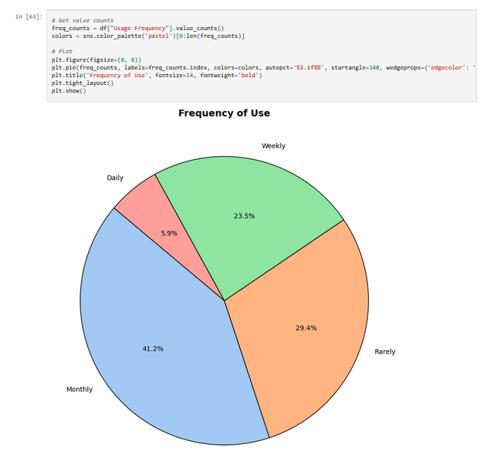
📊 Data Analysis, Python
To analyze the survey data, I utilized Python for cleaning, exploring, and visualizing the responses. Using libraries like Pandas, Matplotlib, and Seaborn, I generated visual insights and answered key research questions that informed the overall UX direction.
Visualizing user satisfaction levels and tool preferences
Identifying top challenges like recognition accuracy
Exploring trends in format preferences and monetization models
🔍 Want to dive into the analysis? Github Link

Slide 6
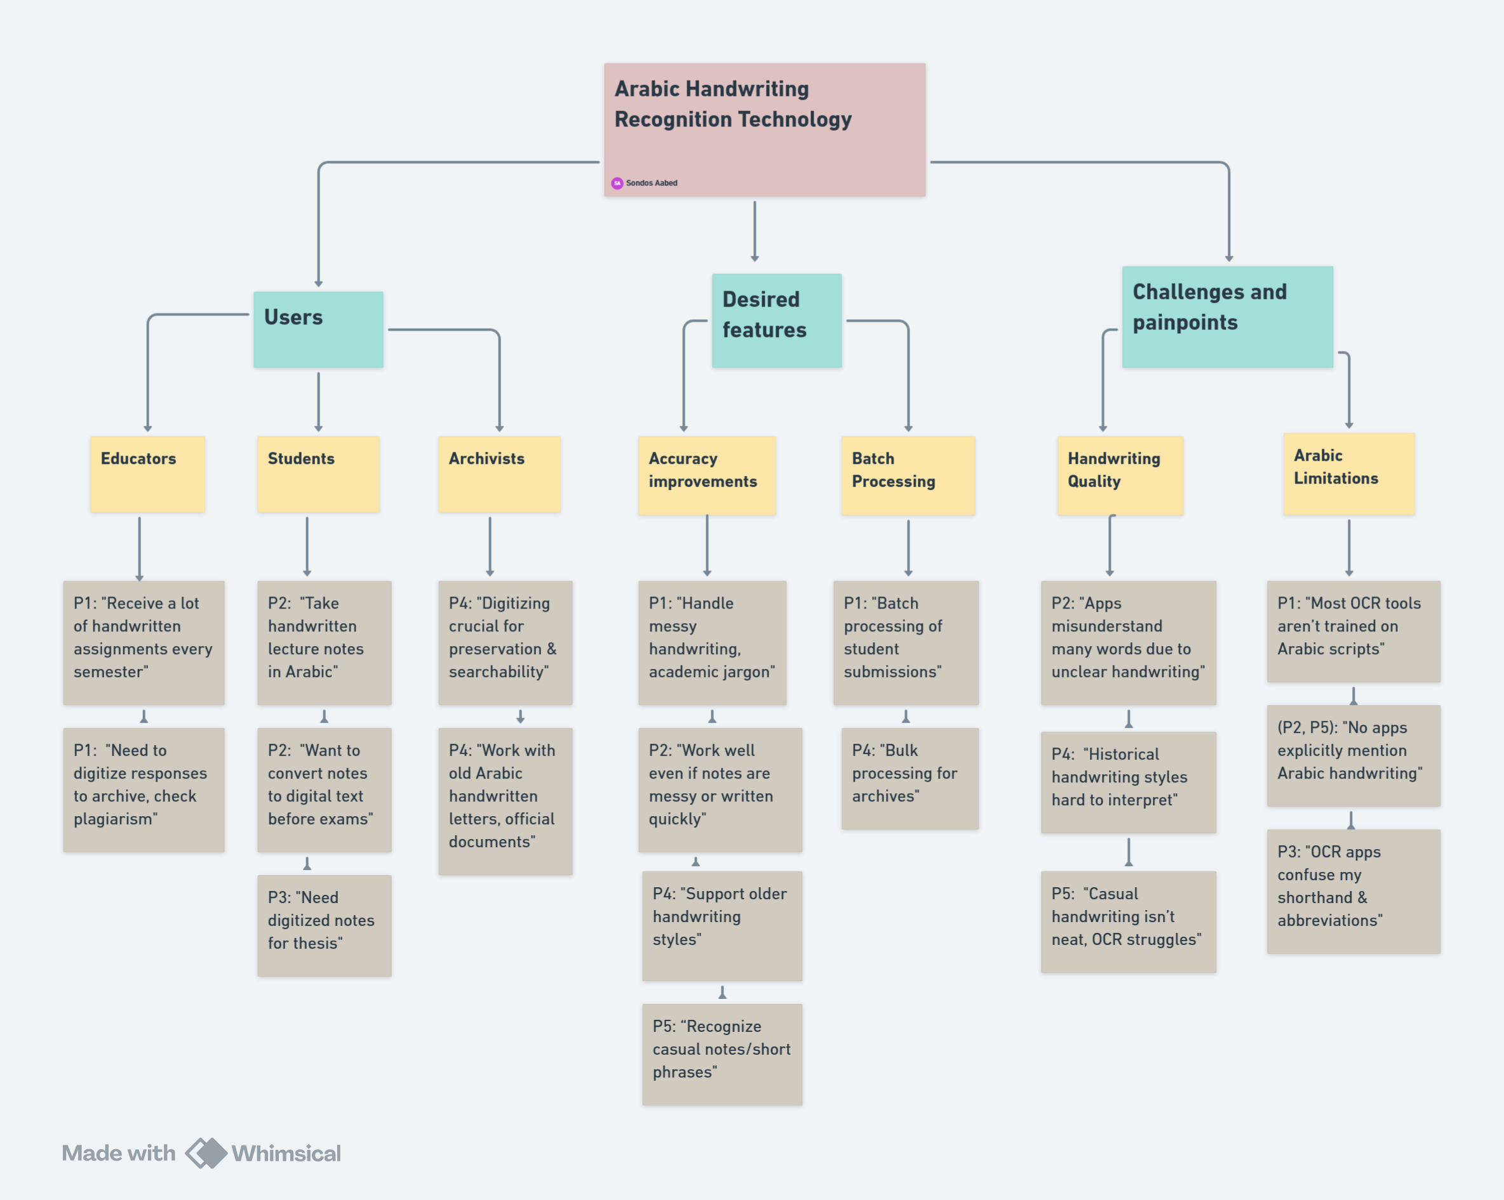
Affinity Diagram
This is all the qualitative data collected in form of affinity diagram where I group data based on themes in common.

Slide 7
💡 Key Findings
82% of users are open to using a mobile app, while only 12% prefer web-based tools.
The top challenge is poor recognition accuracy, with 53% expressing dissatisfaction.
Users want:
Higher recognition accuracy
Editable extracted text
Multi-format export options
Most prefer a free version with ads, though a small segment is open to a monthly subscription.
While privacy concerns were not dominant, they did influence how users prefer to pay or subscribe.

Slide 8
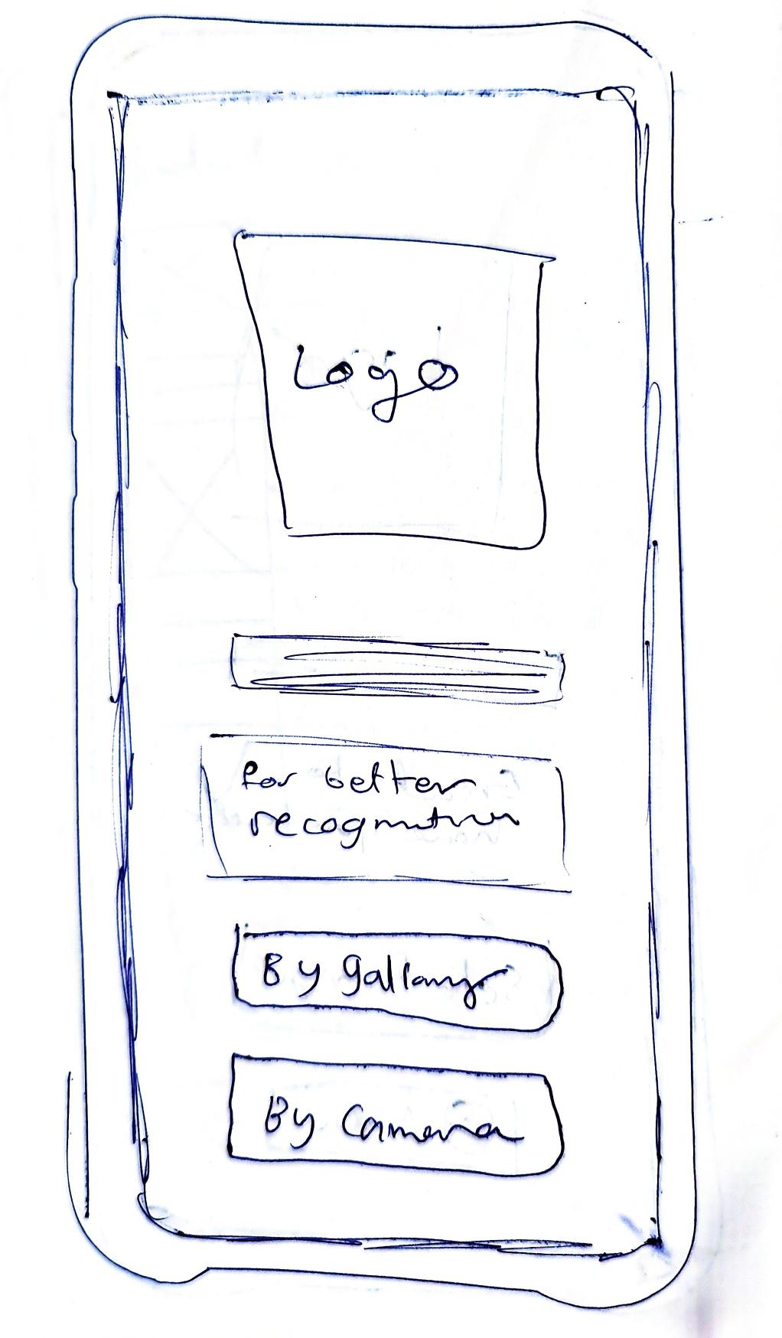
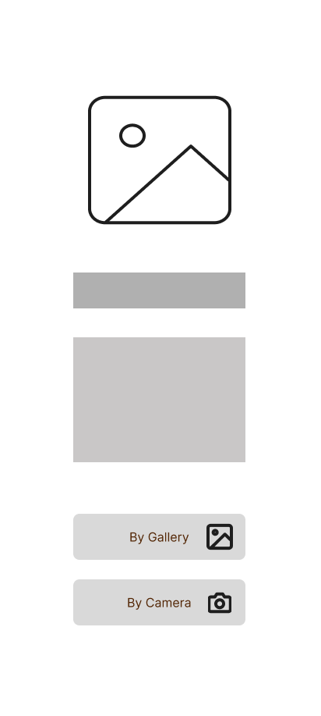
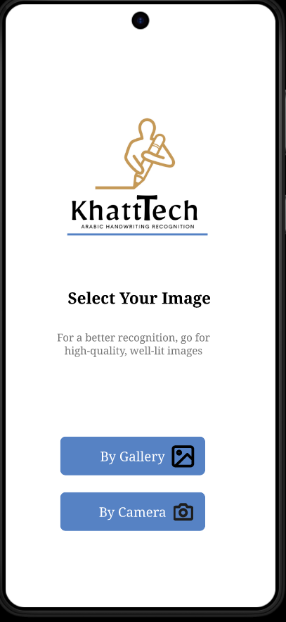
Design: Concepts & Sketching

Slide 9
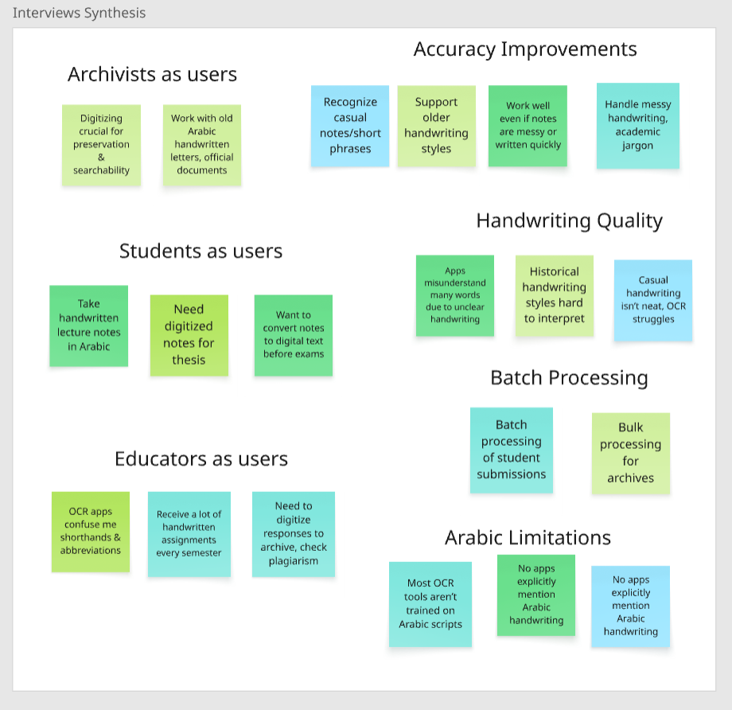
✅ Interviews Synthesis
To synthesize insights from the interviews, I mapped out all collected notes in a digital space (using Miro) to visually organize and group similar comments, behaviors, and needs across participants.
This helped me identify patterns in how users interact with handwritten recognition tools, what they struggle with, and what they expect.
Where this served as directions for solution-building.
🔍 Want to dive into the synthesis? Miro Link

Slide 10
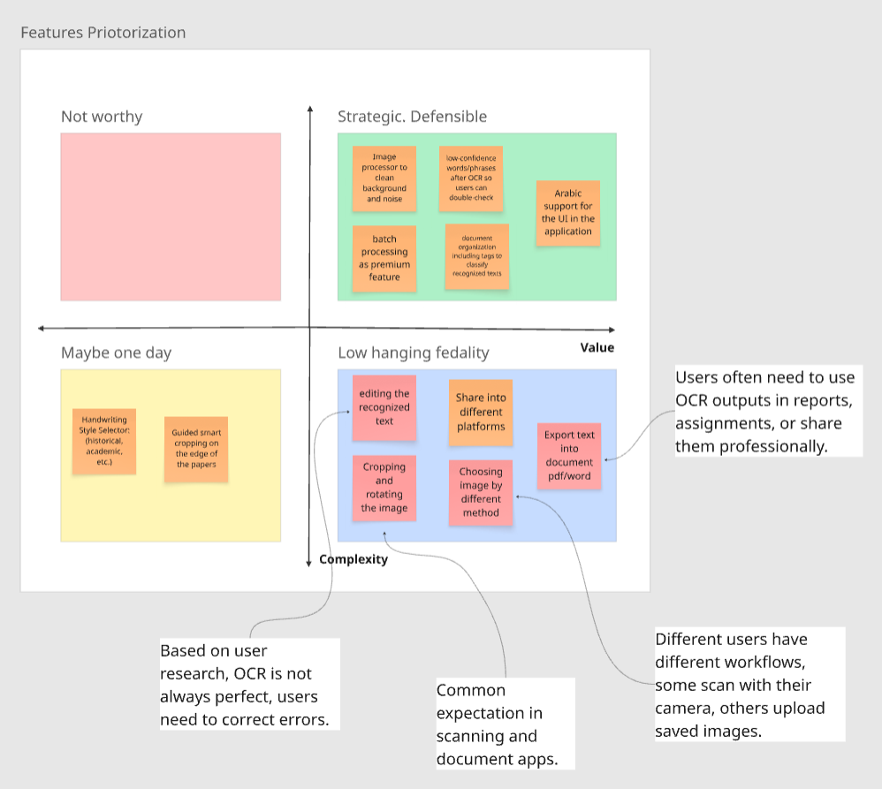
🧠 Features Priotorization
After synthesizing the interview data, I then produced features that I prioritized based on how frequently they appeared across participants, the urgency expressed around them, and their potential to improve user experience.
🔍 Want to dive into the priotorization? Miro Link

Slide 11
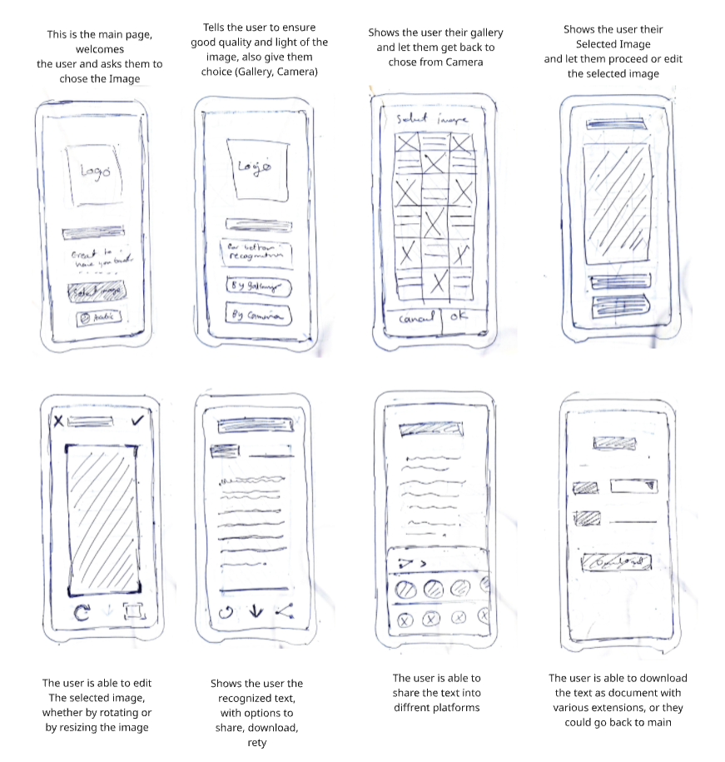
📍Sketches
To begin exploring solutions, I sketched the prioritized features using pen and paper.
These shown low-fidelity sketches helped visualize how the features could function and appear within a real interface.
The sketches were directly informed by the insights gathered during research and organized through a prioritization matrix.
🔍 Want to dive into the Sketched? Miro Link

Slide 12
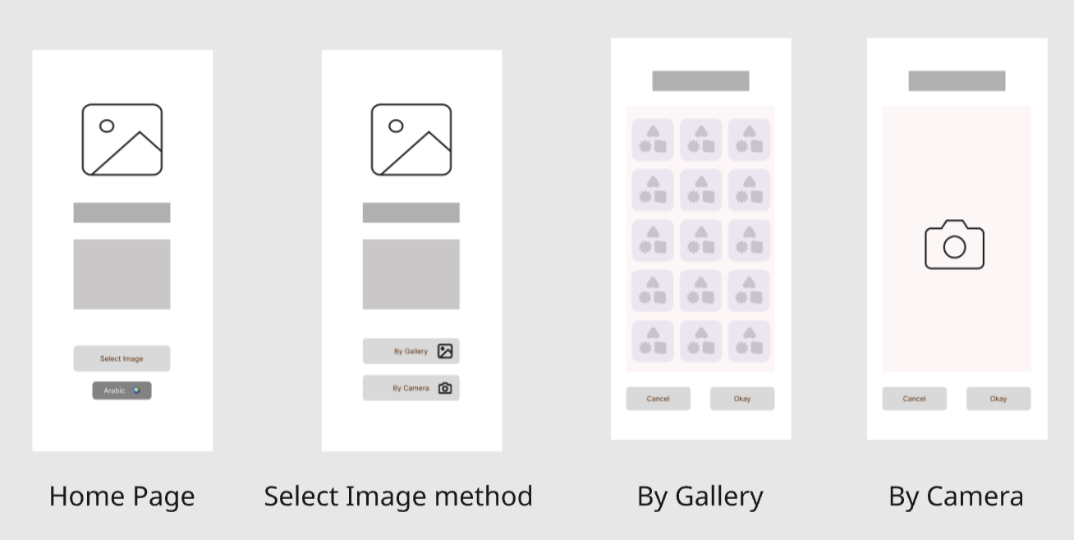
🔅 Low Fidelity Design – Iteration 1
This first iteration translates prioritized features into low-fidelity screens designed in Figma.
The wireframes explore layout and core interactions, bringing research insights into an early visual form.
🔍 Want to have a look ? Figma Prototype Link

Slide 13
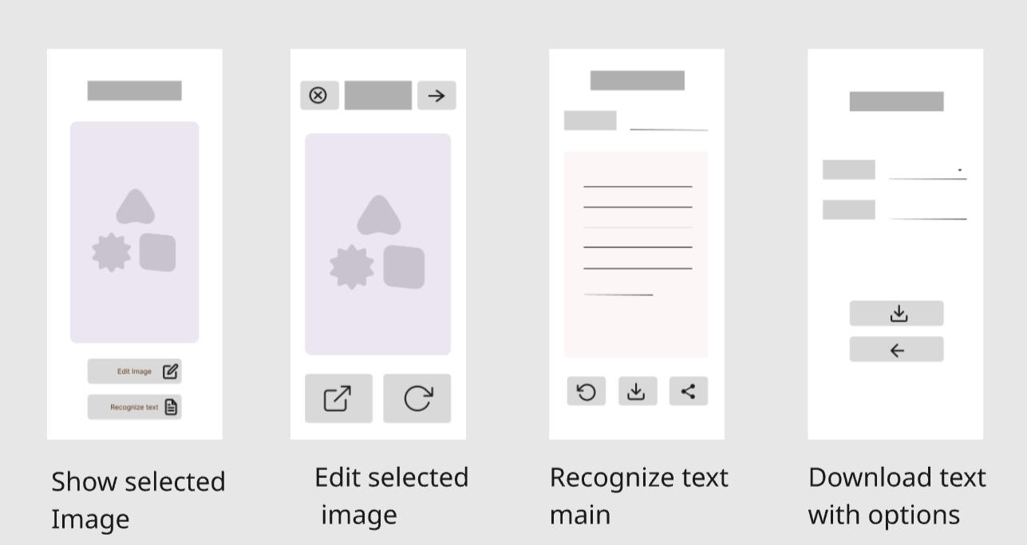
🔅 Low Fidelity Design – Iteration 1, Cont.
These additional screens complete the user flow, capturing key tasks and interactions aligned with user needs from the research phase.
🔍 Want to have a look? Figma Prototype Link

Slide 14
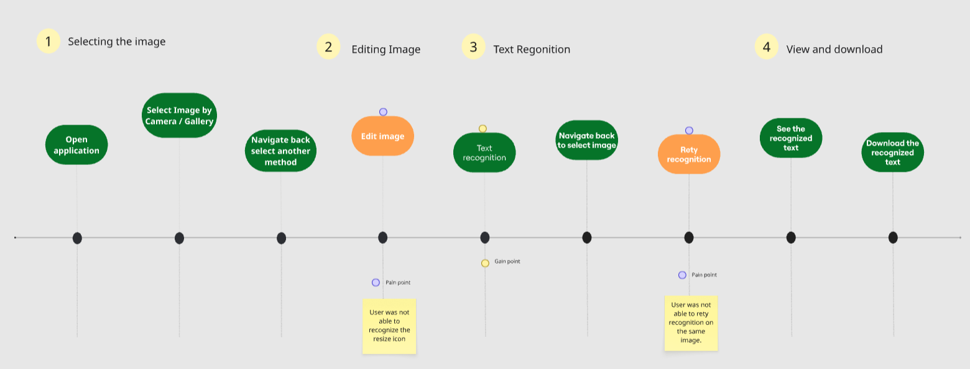
🧪 Usability moderated session
To evaluate the first iteration, I conducted a moderated usability session with a student matching one of our target personas.
The user was asked to complete key tasks using the Figma prototype.
Observations and feedback from the session highlighted usability issues and improvement areas.
🔍 Want to have a look? Figma Link
See below usability flow map and the green highlight successful, while the orange highlight challenge with solution.

Slide 15
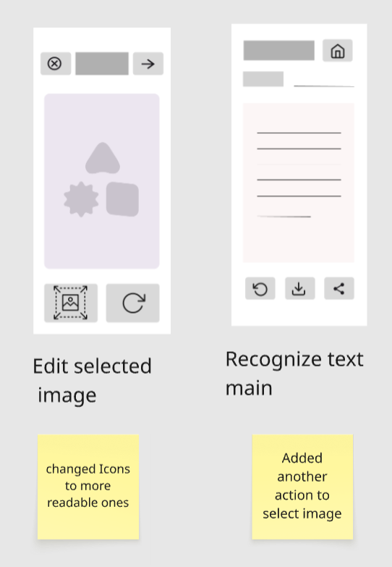
🔅 Low Fidelity Design – Iteration 2
This iteration builds on insights from the usability session. Key changes were made to address pain points identified in the initial prototype
Adjustments aimed to improve overall clarity, navigation, and task completion.
The other screens are kept the same.
🔍 Want to have a look? Figma Design Link Iteration 2

Slide 16
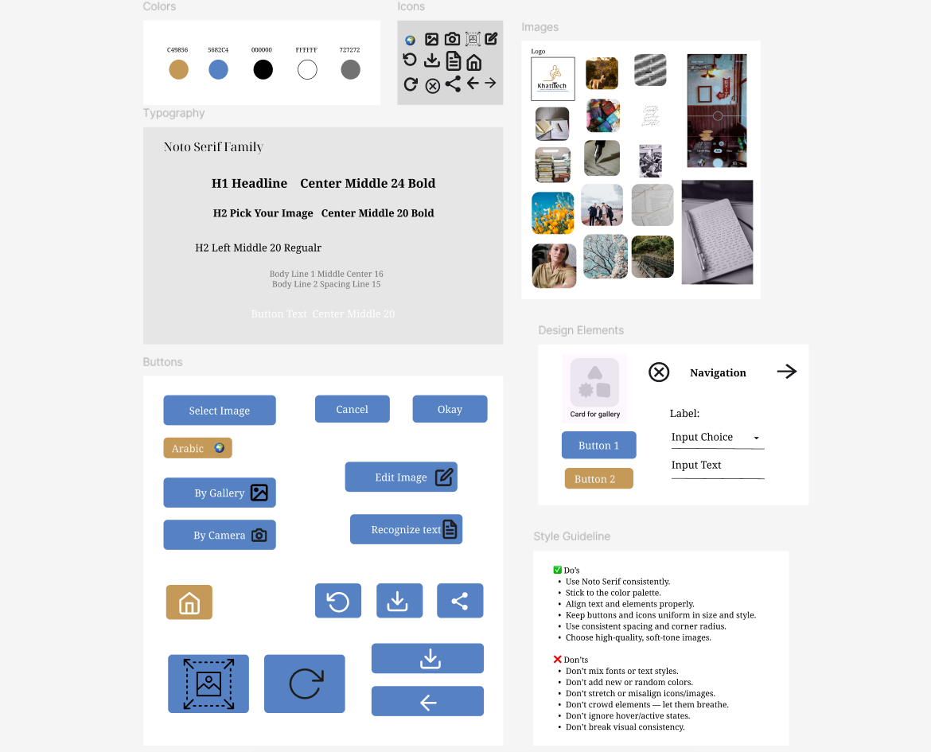
✅ Style guide &
library pattern
Now a style guide and library pattern were used to develop a high-fidelity design.
🔍 Want to have a look ? Figma Design Link

Slide 17
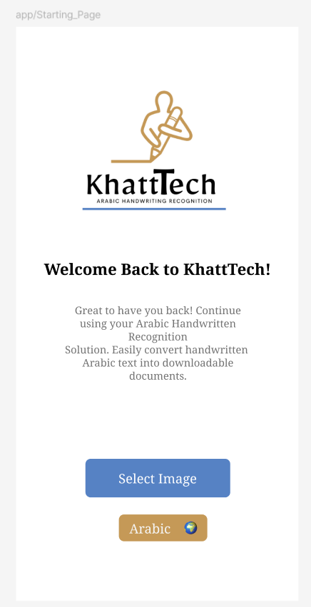
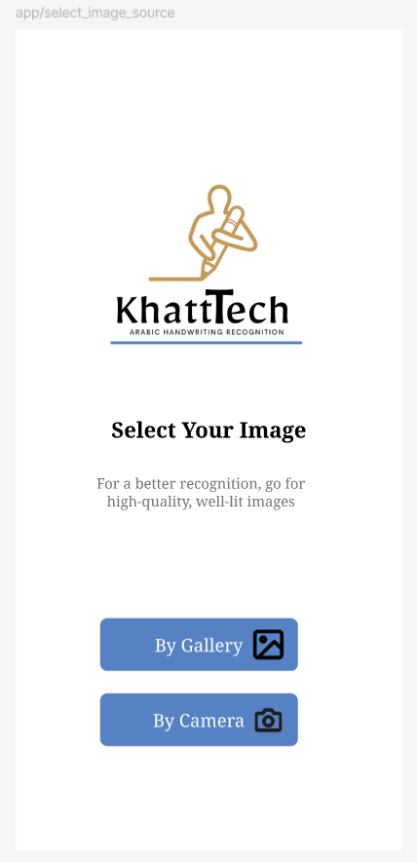
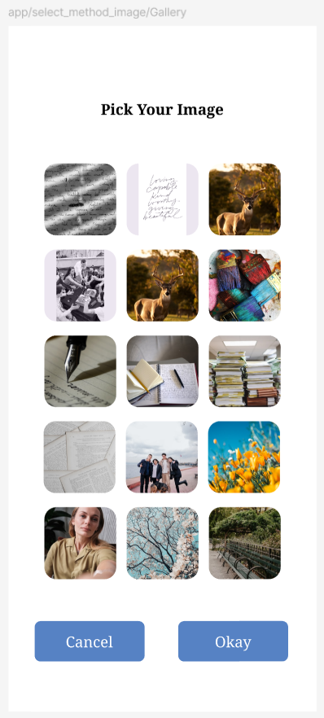
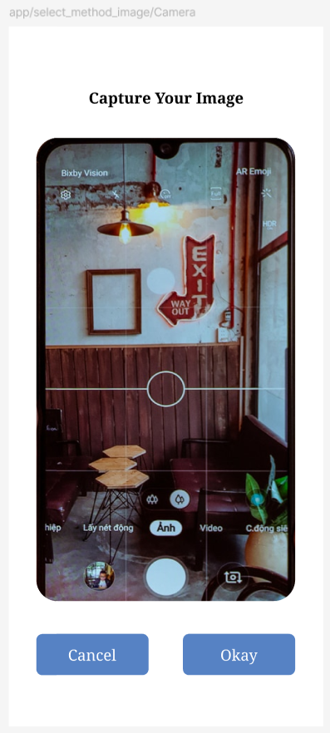
🔅 High Fidelity Design
The low fidelity design were converted into a high-fidelity design.
🔍 Want to have a look ? Figma Design Link

Slide 18
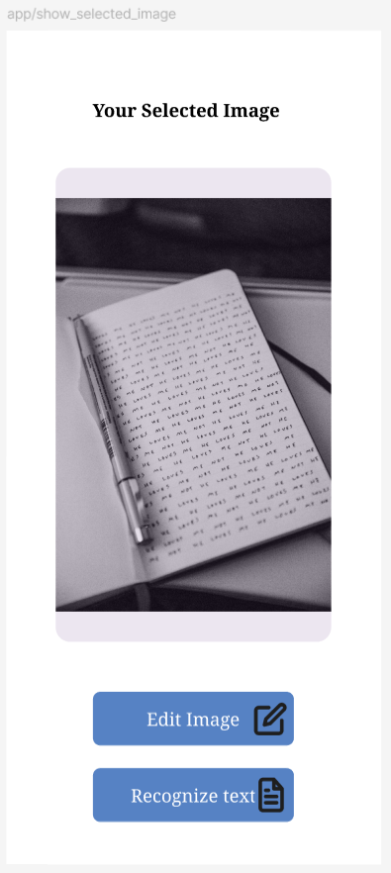
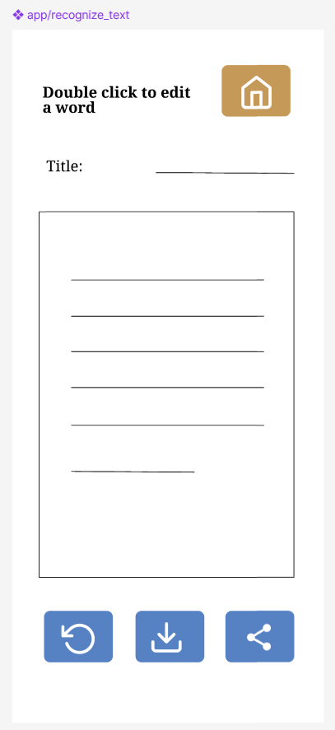
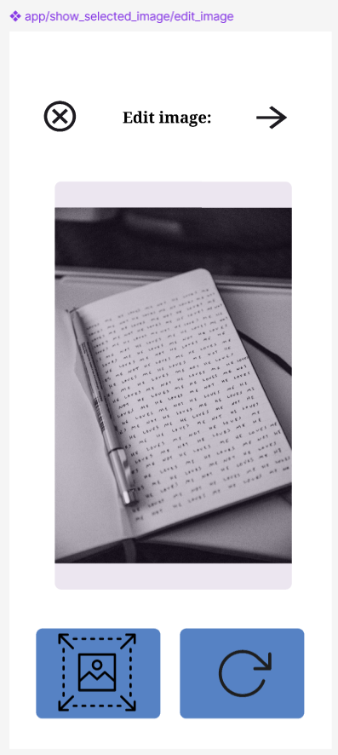
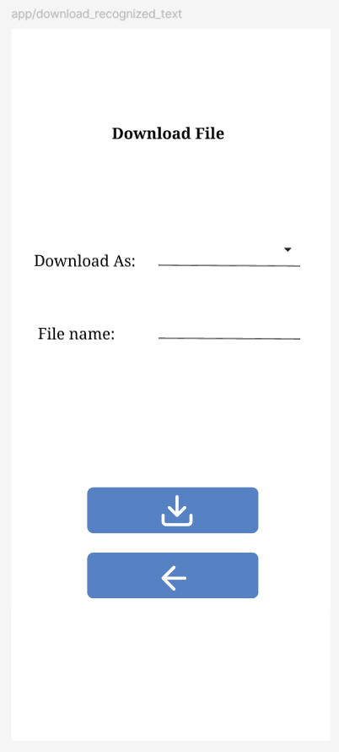
🔅 High Fidelity Design Cont.
The low fidelity design were converted into a high-fidelity design.
🔍 Want to have a look ? Figma Design Link

Slide 19
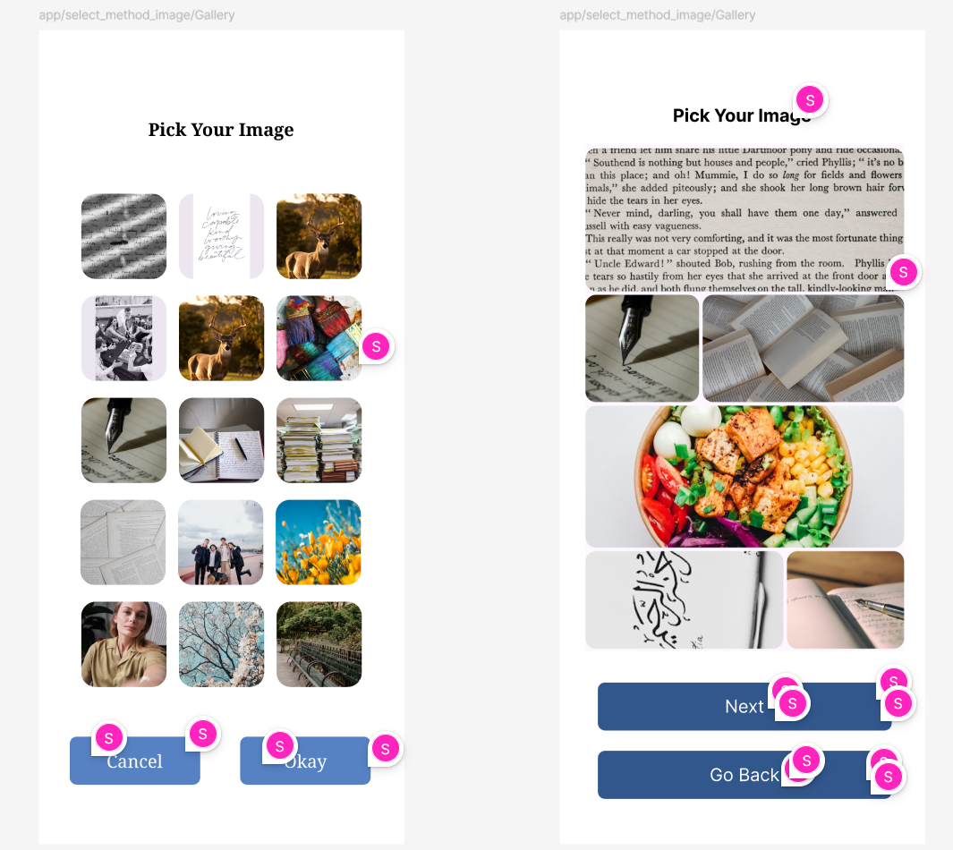
👩🏽‍🎨 Accessibility Improvement
I reviewed and look for issues and opportunities for improvement in accessibility and annotated the screens accordingly.
Implementing these improvements on a new frame and placed them side by side to demonstrate the improvement.
Finally annotated changes I’ve made, including changing CTA and color contrasts.
🔍 Want to have a look ? Figma Design Link

Slide 20
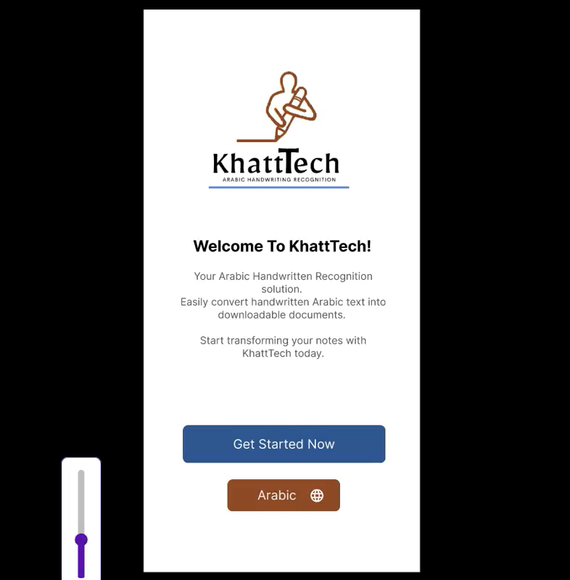
Develop: Prototyping
The enhanced accessibility design were developed into a prototype.
To see more you may visit the below link:
Prototype Figma Link

Slide 21
Test: Validation, Usability, Feedback
For testing purpose, the lookback tool were used for 6 remote (non moderated) testers. They had to complete 4 tasks.
🔍 Key Insights
✅ 83% Completion Rate — One user misunderstood the test; otherwise, 100% success.
⏱️ Task 1 = Slowest (Avg. 33.8s) — Users hesitated or were confused about how to select an image.
🚀 Smoother Flow After Task 1 — Users navigated later tasks faster once the image was selected.
🧭 Task 4 Navigation Issues — Returning home took longer than expected.
💡 User Feedback — One participant suggested redesigning the logo for a more professional look.

Slide 22
📌 Design: Focused Iteration Based on KPI
With a 100% task success rate, the KPI I chose to improve was: 🔽 Decrease Time on Task
🎯 Target Flow: Task 1 – Image Selection
Pain Point: High variance in time (7s to 74s)
Goal: Reduce average to under 20s
💭 Hypothesis
If the image selection screen is simplified with better instructions and clearer visual affordances, users will complete Task 1 faster and more consistently.
💡 Design Changes
🔁 Added a “Change Selection” Button on the preview screen to allow quick image re-selection.
✍️ Updated CTA Text from “Go Back” to “Change Selection” — more intuitive and action-oriented.

Slide 23
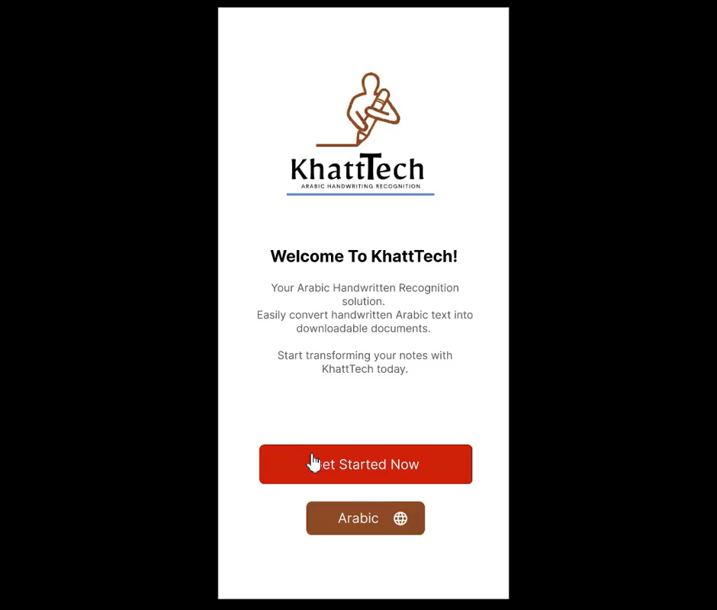
Solution & Impact Overview
Here is my final solution is the shown
And the following is a clickable high-fidelity prototype:
Figma Prototype Link

Slide 24
Outcome Statement
The UX Nanodegree was a transformative journey that sharpened my design thinking and deepened my empathy for users.
I learned to observe, test, and iterate with purpose and discovered how data and human insight come together to shape better experiences.
This experience gave me the confidence for real-world UX challenges with curiosity and intention.

Slide 25
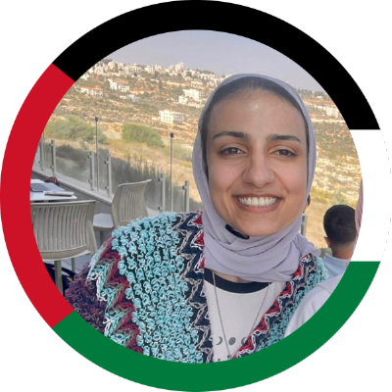
About Me, Rooted in Us
Hi, I’m Sondos, also Sun Dose ☀️🌞, a procurement specialist with computer science bachelor degree. A passionate for thoughtful design and human connection.
My first inspiration will always be nature. its clarity, balance, and quiet brilliance shape with simplicity. This is how I approach both design and life.
I have a background in data analysis and UX research, I love turning complex problems into simple, meaningful solutions. I blend logic with empathy, using tools like Python, Figma, and user interviews to ground every decision in real-world needs.
Outside of tech, I draw, write, learn music and explore the emotional side of human experience.
I believe design should feel honest, kind, and deeply human.

